Slide 1


AVERAGE HOLD TIME (AHT)
Anticipating the difficult by managing the easy!!!

Slide 2


AHT can be understood better by how valuable one treats every second of their time. So before I even start have to make it clear that this PPT will come of no help to those who don’t put an effort into wanting to bring some difference.
Of all one has to be proactive at every instance when in front of the machine.
Going through this slide will show you how a point that you ignored everyday to be trivial could bring drastic changes in your performance as well as your total score card on a whole.
It talks about the general misconception of how the AHT is independent of the quality of call one takes and the most common mistake that people make in a call.
To start with I would like to bring in the qualities that would be majorly affecting ones AHTs and then followed by the minor points.

Slide 3

Summary
Major:
Identify the issue on time
Recognize the time in troubleshooting
Minor:
Having all SMEs personal chat available on SameTime
Talking less typing more
Creating multiple ready to use tickets
Cutting on the call back aux
Utilizing the vacant time available on calls
Taking short breaks during call and not after call
Letting the experts handle half their job
Saving time guiding the client through rather than remoting
Creating templates for common issues

Slide 4
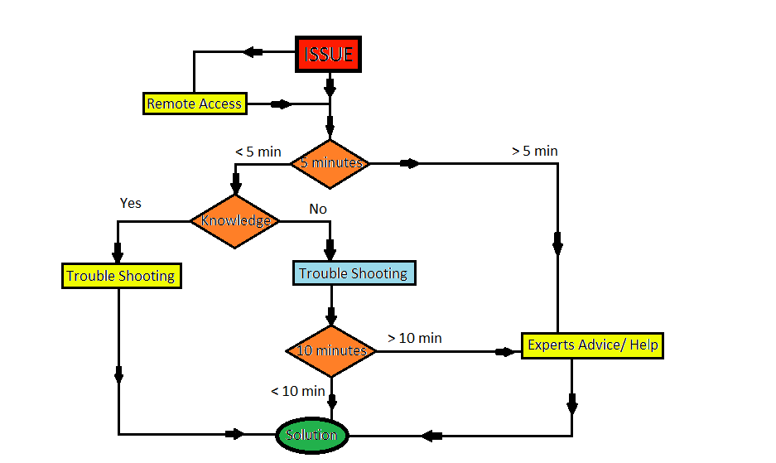
MAJOR POINTS:
Understanding the head in the diagram is the most critical portion in the diagram.
---------
The body is considered to be second in preference.
---------
The conclusion is the least critical.

Slide 5
Time spend in deducing a call
Lesser than 5 minutes you are taking the right path.
The way you can deduce the issue is to probe the client in their own language(cutting down to clarity in your language).
If you don’t understand the issue, accessing the system remotely and then asking the client to demonstrate the issue is the best option.
Reiterate the issue to confirm the clients understanding.
This even enables you to bring up a good understanding with the client .
The understanding of the issue exceeds 5 minutes then its a confirmation that the call would end up with a minimum of 30 minutes, unless you take the right steps.
As soon as you see the time passing 5 minutes its your duty to get to a SME or an experienced person on the floor.
A constant communication with your SME ensures a good relation as well as learning experience on the floor.
It must be understood that only typical issues would fall under this category, hence it must be made sure that you remember the steps of solving the issue even after resolution for future reference.

Slide 6
Resolution after the issue has been recognized
When your affirmative of the situation and know the resolution to the issue (which one would gain only through experience), there is no looking back as to how long you would intend to spend time on the issue.
An Outlook issue, for example, however complicated can never exceed 20 minutes with the right troubleshooting and however easy can never be less than 5 minutes.
So the base point being every issue has its own range time which when understood will enable to deduce the time that could be spend on a particular issue
This way you can compensate for the excess time spend on an “Outlook” issue with a “password reset “or “admin rights” issue.
In majority cases where the issue seems to be surprisingly new its always recommended to get in touch with experts when the time exceeds 10 minutes.
As soon as you see the clock ticking 10minutes on the AVAYA what ever be the situation, its always recommended to have a walk around the floor seeking assistance.
The base point of such situations would be to always make a point to remember the issue when dwelt in future again.
This could be done by memorizing the steps or making a note of it somewhere.
In my case making a note pad and saving it on the cattail.boulder.ibm.com intranet website that IBM provided which can be accessed from any system, hence having no fear of losing data when the system is reimaged or shifted.
Missing the first 10 minutes into an unwary resolution logically results in an expectedly high AHT.

Slide 7
Excluding the generic process related steps as described in the earlier slides my next slides will contain those minor aspects of making your manager happy with your AHT.
All these are simple observation I have made over the period of my work at the Help Desk
Some of them from experienced people, some from my peers who joined alongside me and some from a few risks I took myself that worked out.
Since my work has already talked I would like to put my experience in points to make it easier for others as well.

Slide 8
MINOR POINTS:
The general misconception is staying on a call for some time trying to build a rapport means gaining the confidence of the client that you have put in a good effort into the issue and hence client would be satisfied with your effort(irrespective of whether the issue is resolved or not) which would in turn fetch you a CSAT.
One must understand that the main criteria AT&T focuses on is not achieving CSATs, but instead not getting any DSATs. Therefore cutting short the troubleshooting steps and solving it confidently in the least amount of time will give the client an impression that you understood their issue immediately and was able to find a fix within no time.
For US clients time is valuable, so to take away time by unnecessary troubleshooting is like cutting open the goose considering you’ll find more gold than it lays.
Hence focus on solving the issue rather than discussing about the climate or their extra marital affair.

Slide 9
On SameTime make it a point to open up a personal chat box with all floor SMEs. On encountering an issue ping all the SMEs(available at that time) regarding your issue. At least one of them will respond, and if luck favours, all will respond. The advantage when all respond is that you will have, in case of 6 SMEs, 6 different troubleshooting steps to perform in a matter of 2 to 5 minutes; which saves a lot of time than the usual case of walking up to their desk for every single trouble shooting from one particular SME.
SMEs are humans, so being more considerate, pester them till you get your issue fixed rather than waiting for them to walk up to your bay and assisting you in particular.

Slide 10
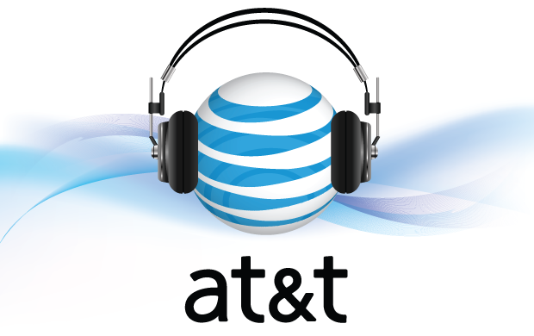
The lesser we talk the more the mind functions. Hence we can type easier when on call listening to the client without talking much. However over the period , out of practise, one can start typing and talking simultaneously. So its preferred to start by talking less and listening more.
The best instance to talk is when you are troubleshooting and applying the fix; explaining the client every steps you have performed and giving a logical reason for why it had been performed.

Slide 11
When getting short calls like “password reset” and “admin rights”, extend the call for up to 9 minutes and close earlier tickets.
If all earlier tickets have already been closed then start creating new tickets filling all their required boxes and leaving the window minimized at the bottom of the AOTS tool. This way when on calls, you can have multiple ready to fill tickets available, which when maximized needs only the ATTUID and Log to be filled. This never slows down the speed of the tool or computer as it has been tested on several systems.
Some of the situations where you can start closing earlier tickets or finding time for other works are during very short calls, installing some software, during conference calls with vendors and while staying on hold.

Slide 12
During calls as soon as the client wishes a “Bye” there is no reason to stay on call. By disconnecting the call and quickly getting back to avail we can save time that is being spend heavily on the call back aux.
Instead those short breaks that are taken during call backs can be taken effectively when on calls with the client with an excuse of verifying their accounts.
Make sure the ticket has been created before the call ends. If its taking time ask the client to wait till the ticket has been created. By performing this way on a regular basis we can learn to create ticket on time before call ends and not needing the client to wait as well.

Slide 13
The easiest and effective way to avoid a DSAT is to ensure the client he is in safe hands.
Sentences like “I’ll make sure...”, “Don’t Worry, we...” and during process asking the client to take his own time to check if the issue is fixed, always creates a positive start and calms any irate client.
Rather than spending a lot of time trying to make sure if a system issue is hardware or software related, we can spend a considerably lesser time by conferencing the call with the vendors. Based on their troubleshooting we can head forward.
When confident of the issue its easier guiding the client through the fix rather than spending a minute or two in trying to remote using the TIVOLI tool.

Slide 14
Creating a common template for most common issues - password reset, application issues conference to ITOSD, admin rights issues, installing applications from tanto, VPN related pin resets and few more - saves us a lot of time by simply copying and pasting the template.
First point of contact when we get an issue which is not known to us is the people around us in the bay, then comes our assigned SMEs, followed by other SMEs and finally the manager.

Slide 15

THANK YOU

